Slide 1

Tap Water for 500,000 Minnesotans Contaminated with Elevated Nitrate
Sarah Porter, Senior GIS Analyst
Anne Weir Schechinger, Senior Analyst of Economics
January 2020

Slide 2
Report Methodology/Structure
To assess the extent of nitrate contaminated drinking water in Minnesota, we analyzed all available state data for public water systems and private wells that use groundwater as source water.
Based on the available data, this report presents the currently known range and severity of nitrate contamination impacts in public water systems and private wells in Minnesota.

Slide 3
Report Structure
According to the Minnesota Department of Health, nitrate contamination of 3 mg/L or higher indicates that the nitrate pollution is caused by humans and not naturally occurring.
Based on research available in 1962, the Safe Drinking Water Act includes a Maximum Contaminant Level of 10 mg/L for nitrate.
To assess the range of impacts between these levels, and to take into account the most recent public health and toxicology literature, this report presents data on public water systems and private wells impacted by three levels of nitrate contamination: contamination at or above 3 mg/L, 5 mg/L and 10 mg/L.

Slide 4
Public Water System Study Results
472,983 Minnesotans drink water from 727 public water systems that are contaminated with at least 3 mg/L nitrate.
Almost 300,000 people drink water from 413 public water systems that are contaminated with at least 5 mg/L nitrate.
More than 150,000 people drink water from 124 public water systems that are contaminated with at least 10 mg/L nitrate.

Slide 5
Public Water System Study Results
 | With at Least 1 test >= 3 mg/L |  | With at Least 1 test >= 5 mg/L |  | With at Least 1 test >= 10 mg/L
System Type | Systems | People Served | Systems | People Served | Systems | People Served
Community | 95 | 405,386 | 55 | 258,985 | 20 | 146,202
Non-community | 632 | 67,597 | 358 | 38,251 | 104 | 8,448
All public ground water systems | 727 | 472,983 | 413 | 297,236 | 124 | 154,650

Slide 6
Private Well Study Results
Tests by the Minnesota Department of Health and Department of Agriculture in the past 10 years show that 7,657 Minnesota households drink from private wells with at least one test at or above 3 mg/L of nitrate.
If each of these private wells serve just three people, it means that private well nitrate contamination impacts almost 23,000 Minnesotans.
EWG also found that at least 368 households have private well test results showing contamination at or above twice the legal limit, or 20 mg/L.

Slide 7
Private Well Study Results
 | At least 1 test at or above 3 mg/L | At least 1 test at or above 5 mg/L | At least 1 test at or above 10 mg/L | At least 1 test at or above 20 mg/L
Households with Private wells | 7,657 | 5,825 | 3,364 | 368

Slide 8
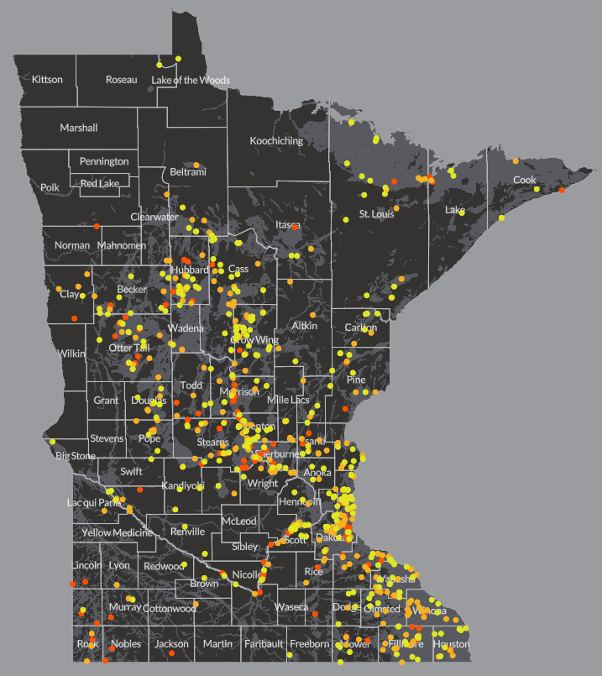
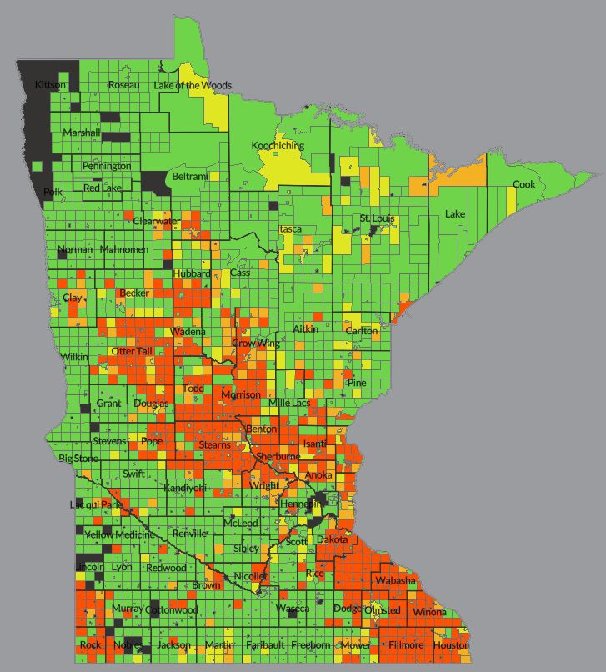
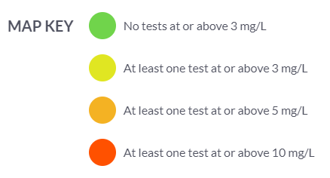
N Contamination is Concentrated in Vulnerable Groundwater Areas
Public Water Systems
Private Wells
The areas of highest vulnerability, as defined by MDA, make up almost one-fourth of MN.
89% of public water systems with at least one test at or above 3 mg/L were within 1 mile of a highly vulnerable groundwater area.
87% of private wells with at least one test at or above 3 mg/L were within a township comprised of at least 25% highly vulnerable groundwater area.

Slide 9
Environmental Justice Impacts
Nitrate contamination of drinking water disproportionately impacts rural Minnesotans.
  85% of public water systems with at least one test at or above 5 mg/L serves people living in rural Minnesota.
  98% of townships with at least one domestic well test at or above 5 mg/L are in rural Minnesota.
Nitrate contamination of drinking water severely impacts lower-income Minnesotans.
  About 50% of the communities and households affected by high nitrate levels are located in areas where household incomes fall below the state median.
Notes:
Of 413 public water systems with at least one test at or above 5 mg/L, 203 are located in U.S. Census block groups where household income is less than the state median.
Of 617 townships with at least one private well detection at or above 5 mg/L, 299 are also in areas with household income below the state median.

Slide 10
New Information on the Negative Health Impacts
Under the federal Safe Drinking Water Act, the legal limit for nitrate in drinking water is 10 mg/L.
The federal limit for nitrate was set, in 1962, to guard against “blue baby syndrome.”
More current research indicates that levels below 5 mg/L nitrate are associated with higher risks of colorectal cancer, thyroid disease and adverse birth outcomes.

Slide 11
Comprehensive Policy Needed to Immediately Address Agricultural Sources of Nitrate
Commercial fertilizer and feedlot manure are, by far, the largest sources of nitrate in Minnesota.
In the highly vulnerable groundwater area delineated by MDA there are 2.5 million acres of cropland and 6,287 livestock feedlots.
If these agricultural sources of nitrate are not immediately and comprehensively addressed, nitrate groundwater contamination in Minnesota will continue to get more severe and individuals and communities will be forced to bear even greater treatment costs.

Slide 12
Questions?
craig@ewg.org
jkonopacky@ewg.org

Slide 13

More on Data and Methods…

Slide 14
Public Water Systems
Includes both community and non-community systems:
  Community Water Systems are mostly cities, towns, mobile-home parks
  Non-community Water Systems are schools, churches, campgrounds, gas stations, etc. (people generally don’t live there, at least not full time)
Data is from the Minnesota Department of Health.
  All nitrate tests except 2018 are in EWG’s Tap Water Database.
Analyzed the number of public water systems and their populations served that had at least 1 nitrate test at or above 3, 5 and 10 mg/L.

Slide 15
Public Water Systems Cont.
All active groundwater systems that tested for nitrate between 2009-2018:
System Type | System Count | % of systems | Population | % of population
Community | 869 | 13% | 3,014,139 | 84%
Non-community | 5,697 | 87% | 576,840 | 16%
Total | 6,566 |  | 3,590,979

Slide 16
Public Water Systems Cont.
Active groundwater systems that had at least 1 test >= 3, 5 or 10 mg/L between 2009-2018:
 | With at least 1 test >= 3 mg/L |  | With at least 1 test >= 5 mg/L |  | With at least 1 test >= 10 mg/L
System type | Systems | Population | Systems | Population | Systems | Population
Community | 95 | 405,386 | 55 | 258,985 | 20 | 146,202
Non-community | 632 | 67,597 | 358 | 38,251 | 104 | 8,448
All public ground water systems | 727 | 472,983 | 413 | 297,236 | 124 | 154,650

Slide 17
Nitrate in Private Wells

Slide 18
Private Drinking Water Wells
Private well data came from four different state programs focused on sampling private wells for nitrate.
MDA: Central Sands Volunteer Nitrate Testing
MDA: Southeast Volunteer Nitrate Testing
MDA: Township Testing (Initial and Follow-up Sampling)
MDH: New Domestic Well Testing
Each program has a different testing frequency and scale at which data are reported.

Slide 19
Private Drinking Water Wells Cont.
Just under 1.3 million people (22%) of the state, get their drinking water from private wells.
Nitrate data was collected for 77,456 households between 2009 and 2018 from 4 programs.
  7,657 wells (10%) had at least 1 test >= 3 ppm
  5,825 wells (7.5%) had at least 1 test >= 5 ppm
  3,364 wells (4.3%) had at least 1 test >= 10 ppm

